Slide 1
CORAL
A Real-time Sentry for the World’s Oceans
Developed by Joseph Farah in Python

Slide 2
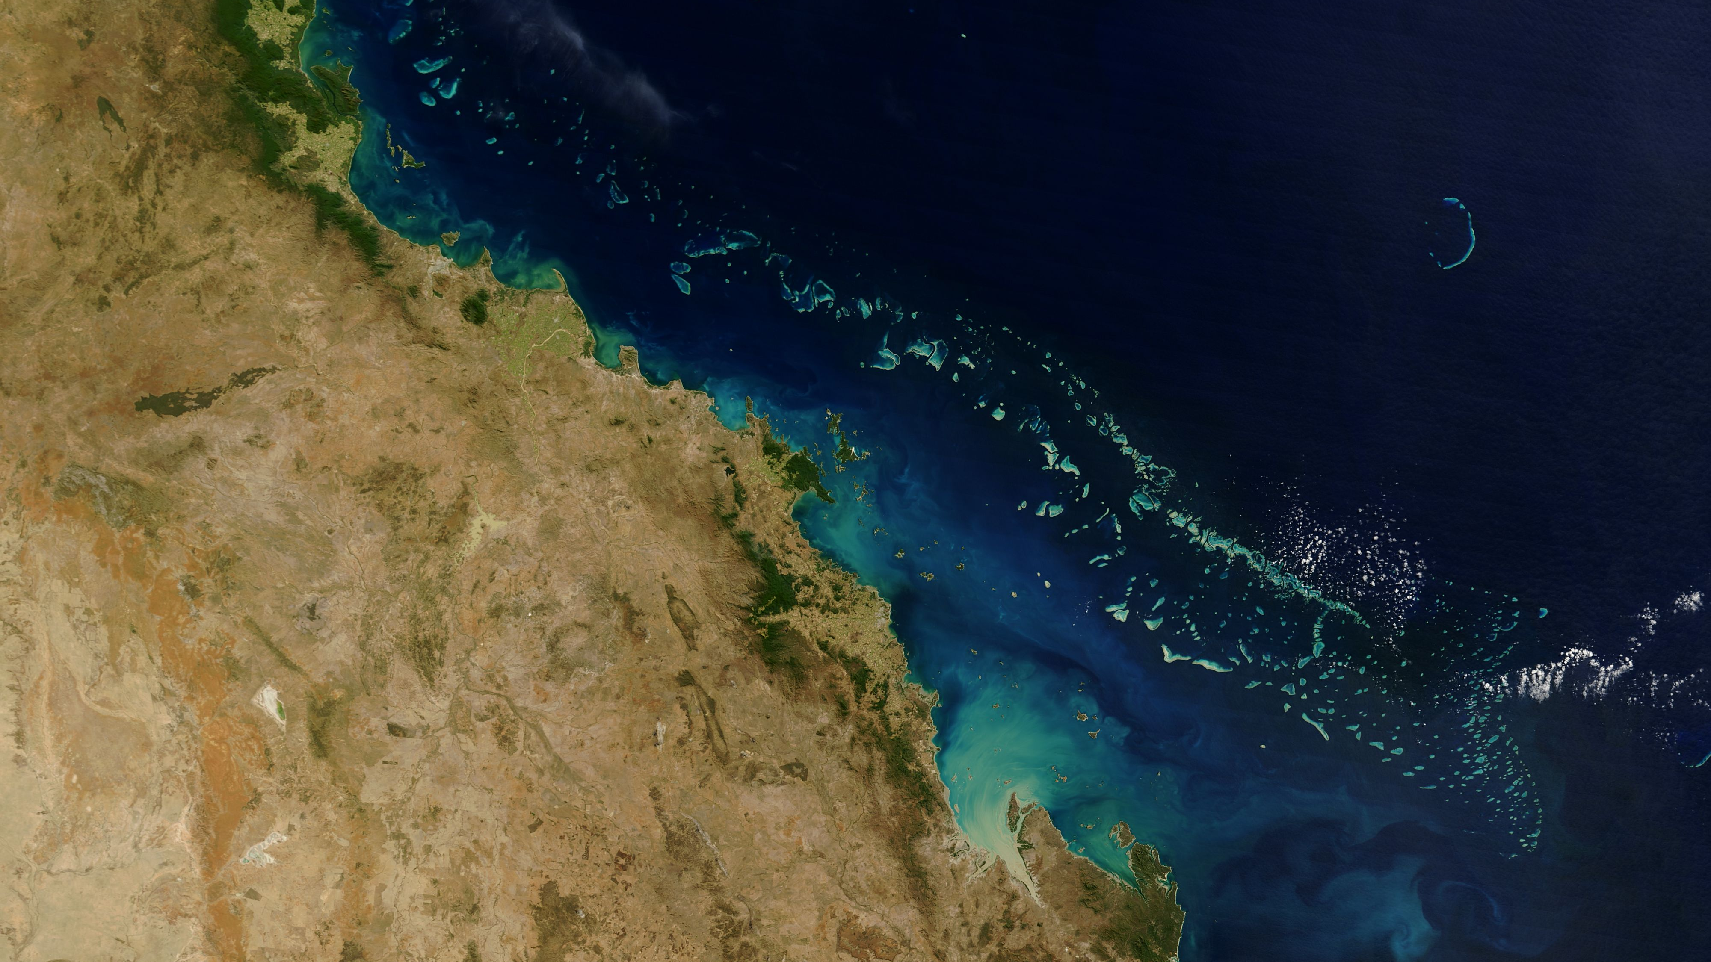
What are coral?
A living creature—thousands of colonies of tiny coral polyps calcifying limestone to form hard outer shells, closely related to jellyfish
Home to 25% of the world’s marine life
Helps direct the course of evolution in the ocean
Coral reef plants and animals are important sources of new medicines being developed to treat cancer, arthritis, human bacterial infections, Alzheimer’s disease, heart disease, viruses, and other diseases. (Source: NOAA)

Slide 3
The reefs are dying.
93% of climate change heat is absorbed by the ocean
Coral reefs require specific pH ranges
Support 25% of all marine life, despite covering only 1% of the ocean floor
60% of the world’s reefs are threatened by human activity
99% of the world’s reefs are projected to experience bleaching in the next few decades

Slide 4
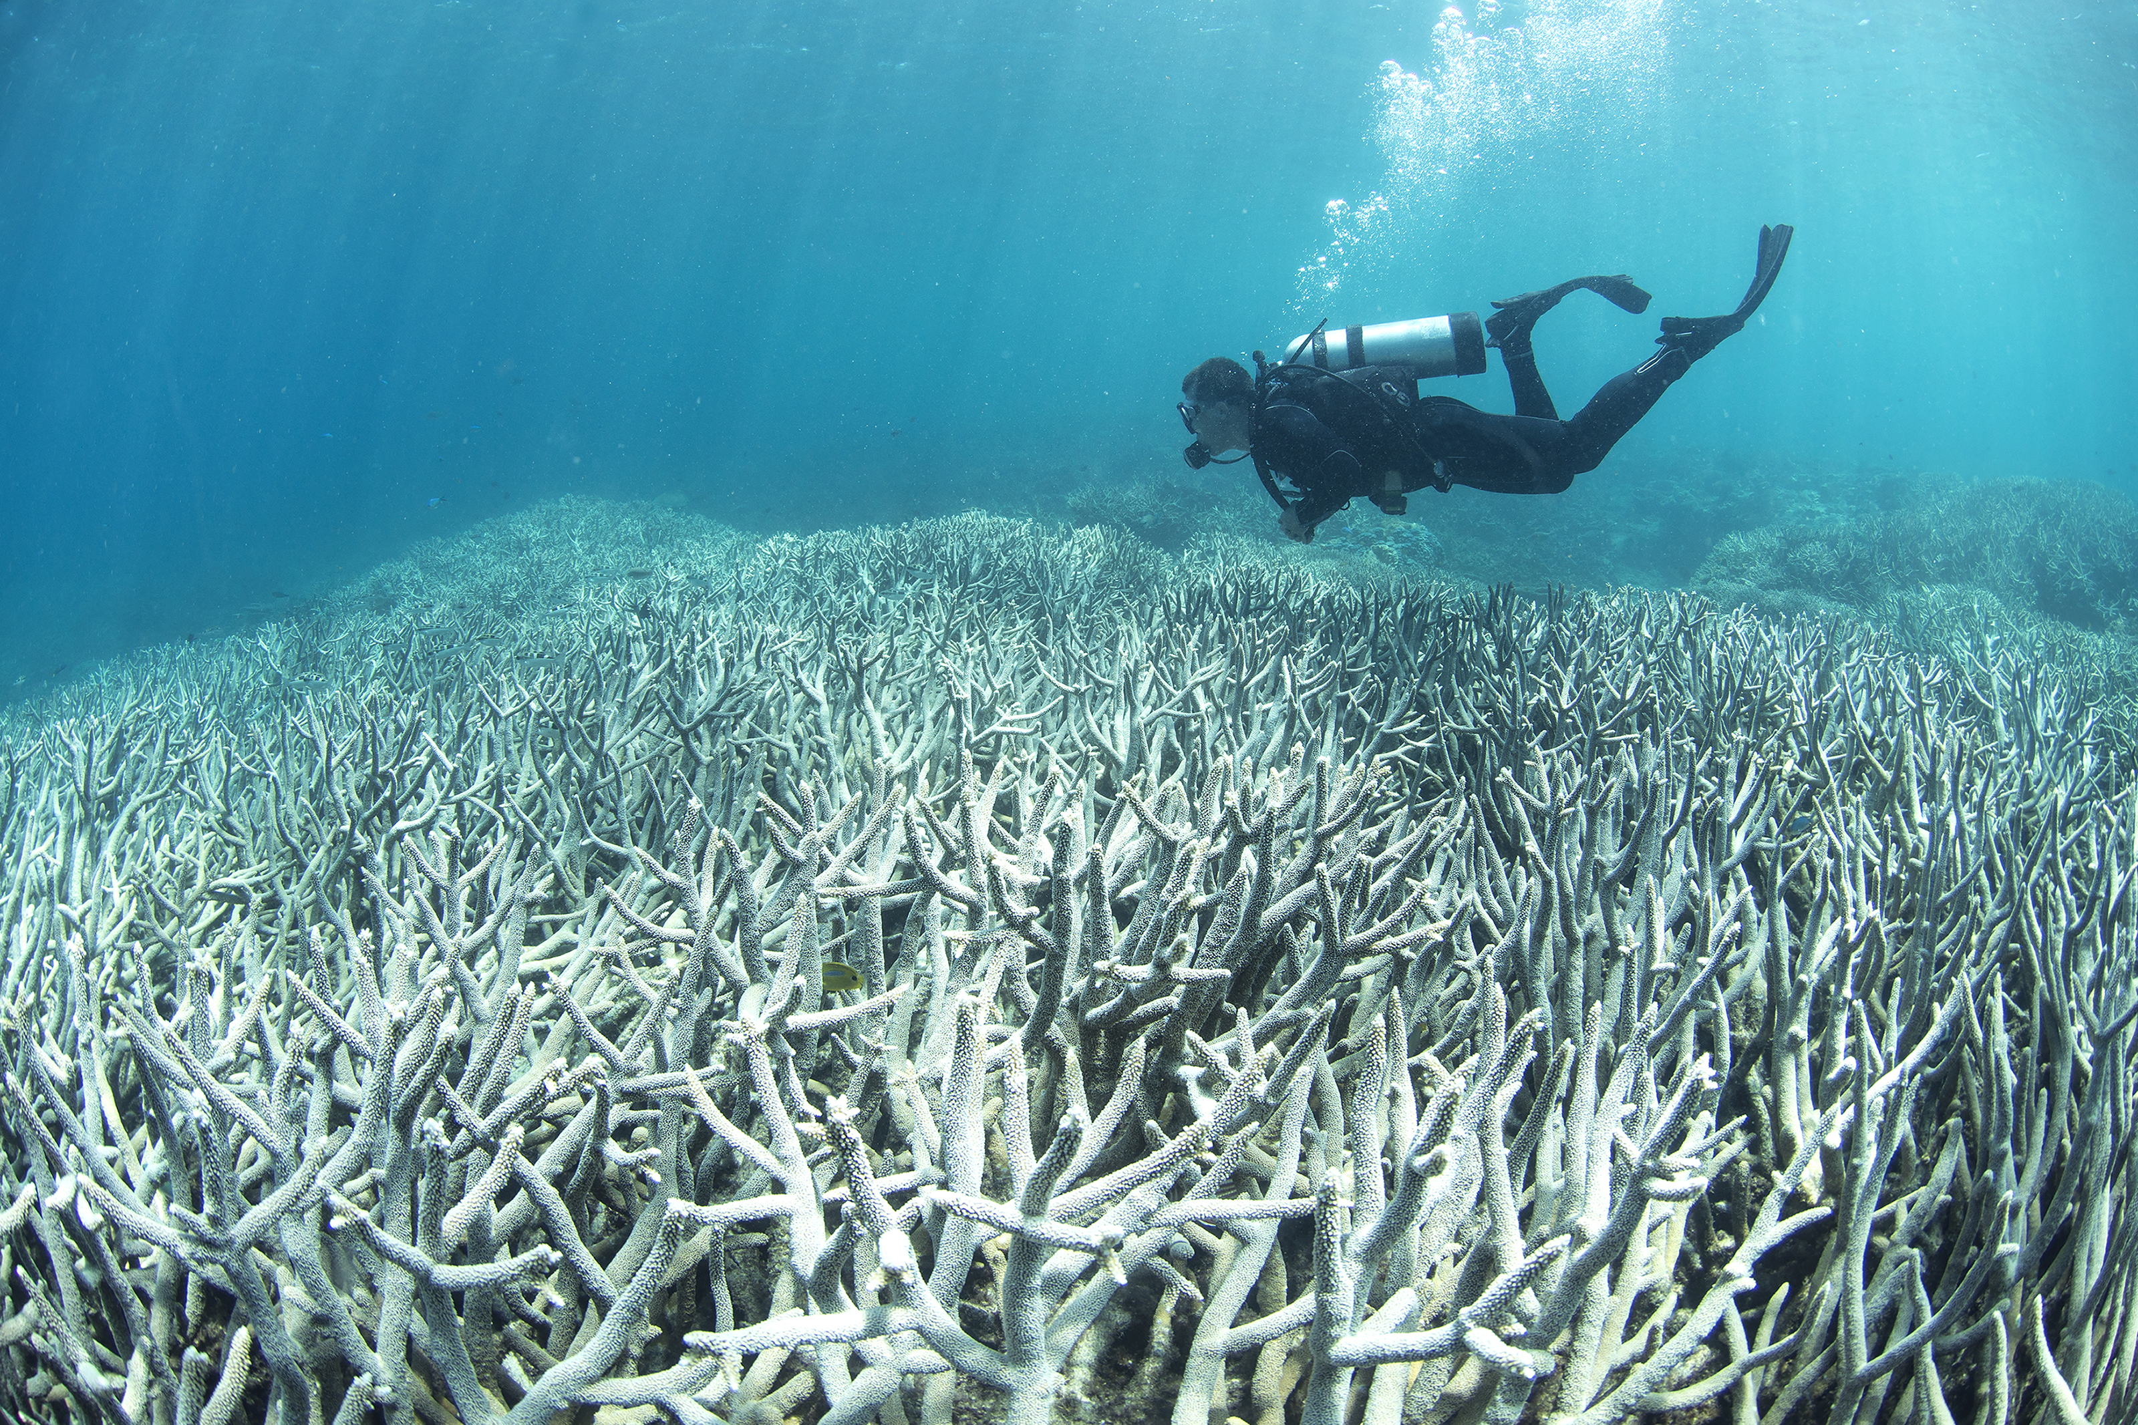
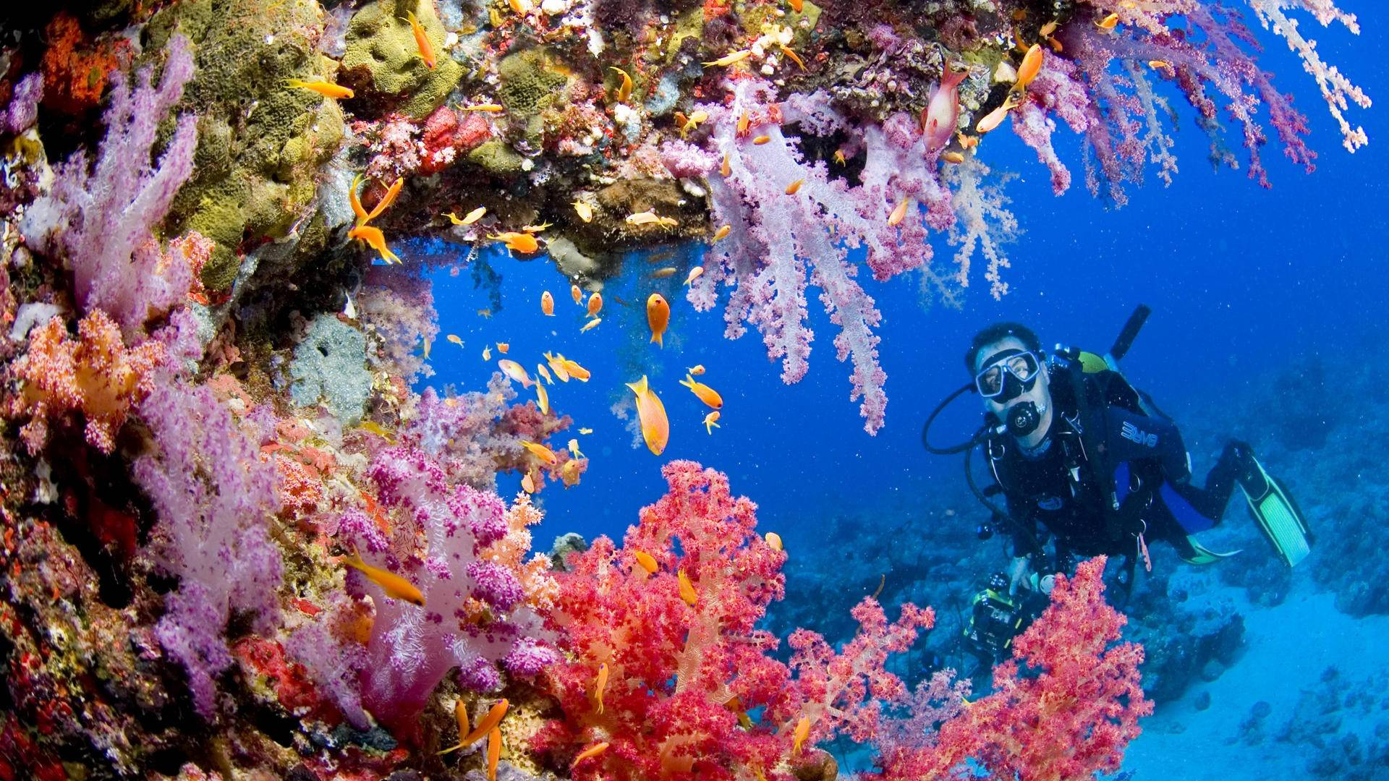

Slide 5
What is CORAL?
A central hub for real-time data from the National Oceanic and Atmospheric Administration
A tool for scientists to monitor reef stress around the world and compare world conditions to world bleaching percentages
An interactive and engaging way to encourage interest in protecting one of Earth’s most important and beautiful resources

Slide 6
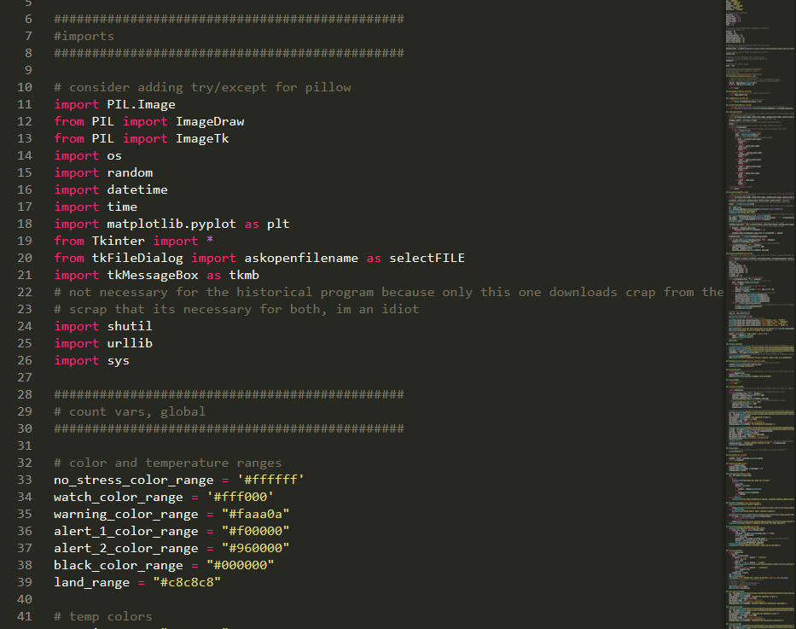
Built from the ground up with Python2.7
Coded 100% in Python
Modules used:
PIL (Python Image Library) for analysis of NOAA maps
MATPLOTLIB and PyRoot for graphing
Tkinter for GUI interactions
Urllib for image scraping
Why Python?
Extremely versatile
Easy GUI framework
Easier to allow newcomers to create additional functions for the software (due to readability of existing code)

